Slide 1
Voice fingerprinting for authentication
Created By: Ong Koon Han
(koonhan.ong.sg@gmail.com)

Slide 2
Agenda
Problem Statement
DL Model Training Approach
Data Preprocessing
Voice Encoder via Contrastive Learning
Binary Classifier for Authentication
Model Performance
Mobile App Deployment

Slide 3
Problem Statement

Slide 4
Problem Statement
Speaker Identification: n-classification task, given an input utterance, identity the right speaker out of n speakers (classes)
Speaker Verification: Binary classification task, given an input utterance by a speaker with a claimed identity, determine if that claimed identity is correct
In this project, the voice authentication problem is framed as a speaker verification problem

Slide 5
DL Model Training Approach

Slide 6
DL Model Training Approach
We do not want to limit the no. of inputs when training the model
Pure binary classification (only 2 inputs at a time)
Contrastive learning with triplet loss (only 3 inputs at a time: reference, positive, negative)
2 stage approach taken in this project
Training of a speaker encoder via contrastive learning with multiple inputs
Training of a binary classifier on top of the trained encoder
Speaker voice samples converted to spectrograms
Convert audio signal into images
Use image model as base model

Slide 7
DL Model Training Approach
Related Works
Jung, et. al. (2017) Presented a speaker verification system that uses CNN with a raw waveform input
Chen, et. Al. (2020) Presented a framework for contrastive learning of an image network, including a way to sample minibatches, and a contrastive loss function for the sampled minibatches
Le and Odobez (2018) Presented a speaker embedding using triplet loss with intra-class distance variance regularization

Slide 8
DL Model Training Approach
References
Chen, T., Kornblith, S., Norouzi, M. and Hinton, G., 2020. A simple framework for contrastive learning of visual representations. arXiv preprint arXiv:2002.05709.
Jung, J., Heo, H., Yang, I., Yoon, S., Shim, H. and Yu, H., 2017, December. D-vector based speaker verification system using Raw Waveform CNN. In 2017 International Seminar on Artificial Intelligence, Networking and Information Technology (ANIT 2017). Atlantis Press.
Le, N. and Odobez, J.M., 2018, September. Robust and Discriminative Speaker Embedding via Intra-Class Distance Variance Regularization. In Interspeech (pp. 2257-2261).

Slide 9
Data Preprocessing

Slide 10
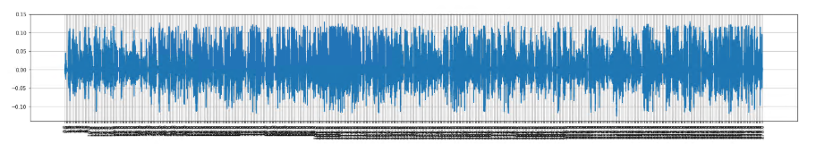
Data Preprocessing
VoxCeleb1 public dataset was used
Contains audio segments of multiple speakers in the wild
Speakers are being interviewed and audio segments represent segments where the speaker is speaking
Contains multiple interviews per speaker with different settings and equipment used
Video was not used in this project, only audio
Multiple short audio samples from the same speaker were combined into one long audio sample

Slide 11
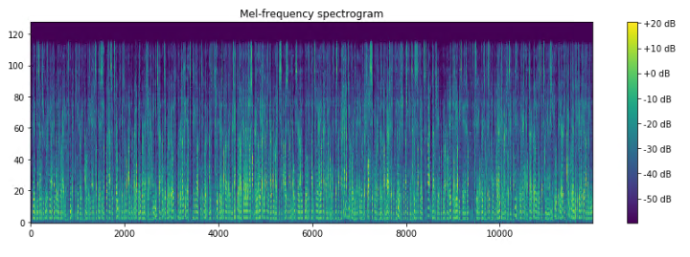
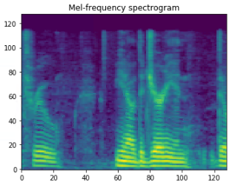
Data Preprocessing
Long audio samples converted to spectrograms using Librosa library
Target sampling rate: 22050
STFT window: 2048
STFT hop length: 512
Mels = 128
Power spectrum converted to Decibels
Sampling is done by slicing off smaller spectrograms from the long spectrogram
128 x 128 x 3 spectrogram “images”
Random start point on long spectrogram
Three 128 x 128 spectrograms obtained by sliding the window half a step (128/2=64)
Normalized by largest abs value in the slice

Slide 12
Voice Encoder via Contrastive Learning

Slide 13
Voice Encoder via Contrastive Learning
Data Sampling
Batches generated by ContrastiveDataGenerator() in data_generators.py
Spectrogram slices will be referred to as “images”
For each epoch, 200 (total 1,000) random full-length spectrograms are loaded into memory (due to resource constraints) (“sub-samples”)
For each row, 1 reference and 5 candidates were used
Candidate images contain 4 negative and one positive image
Images are randomly generated from the sub-samples
Epoch: 2,000 rows
Batch size: 15 (MobileNetV2) and 6 (DenseNet121)

Slide 14
Voice Encoder via Contrastive Learning
Multi-Siamese Encoder Network
Encoder Network
SpectrogramEncoderNet() in model_definitions.py
Base models: MobileNetV2, DenseNet121
Encoder layer size: 128 (replacing imagenet classifier in base models)
Contrastive Model Wrapper
MultiSiameseContrastiveClassifierNet() in model_definitions.py
Wrapper for cosine similarity computation

Slide 15
Voice Encoder via Contrastive Learning
Contrastive Loss + Intra-Class Variance Reduction
The two objectives (contrastive loss and variance reduction) are minimized consecutively
(Due to resource constraints, ideally the two objectives should be summed and minimized)
Contrastive loss: every batch
Variance reduction: every 2 batches
Contrastive loss
Following Chen, et. Al. (2020), the problem is formulated as a n-classification problem where the model tries to identify the positive image from among all the candidates
Cosine similarity is computed for all candidate encodings against the reference encoding
Softmax is computed over the cosine similarities and cross entropy loss is minimized
Intra-class variance reduction
The images from the same class are pushed closer together in encoding space
Images from the same class/speaker are sampled, and the mean encoding vector is computed
MSE loss of the encodings is minimized against the mean (variance)
MSE loss is scaled by 0.20 before backpropagation

Slide 16
Voice Encoder via Contrastive Learning
Multi-Siamese Encoder Model
Contrastive Learning
Query
Spectrogram
Shared
Spectrogram Encoder
Query
Encoding
Cosine Similarity
(Query vs Candidates)
Softmax
+
Cross Entropy Loss
Candidate
Spectrograms
Candidate
Encodings
Intra-Class Variance
Reduction
Mean Encoding
MSE Loss
Same Class
Spectrograms
Same Class
Encodings

Slide 17
Binary Classifier for Authentication

Slide 18
Binary Classifier for Authentication
Data Sampling
Batches generated by VerificationDataGenerator() in data_generators.py
For each epoch, 200 (total 1,000) random full-length spectrograms are loaded into memory (due to resource constraints) (“sub-samples”)
For each reference image, 2 test images are generated
2 test images: 1 positive and 1 negative image
2 pairs/rows generated for each reference
Positive pair (Genuine)
Negative pair (Impostor)
Images are randomly generated from the sub-samples
Epoch: 4,000 rows, Batch size: 320 (MobileNetV2 and DenseNet121)

Slide 19
Binary Classifier for Authentication
Verification Binary Classifier Network
Underlying Encoder Network
Pre-trained encoder network from contrastive learning step
Weights frozen during training
Siamese Binary Classifier Network
VerificationBinaryClassifierNet() in model_definitions.py
Abs diff of encoding vectors of the input pairs
Classifier built on top of abs diff layer

Slide 20
Binary Classifier for Authentication
Siamese Binary Classifier
Shared
Spectrogram Encoder
Reference
Spectrogram
2 class
Cross Entropy Loss
Abs Diff of Encodings
Binary Classifier
(FC layers)
Test
Spectrogram

Slide 21
Model Performance

Slide 22
Model Performance
Effect of Intra-Class Variance Reduction
Variance reduction improves classification performance across both base models
Performance of MobileNetV2 with variance reduction improves to a level comparable to DenseNet121
Using a larger model also improves classification performance (MobileNetV2 vs DenseNet121)

Slide 23
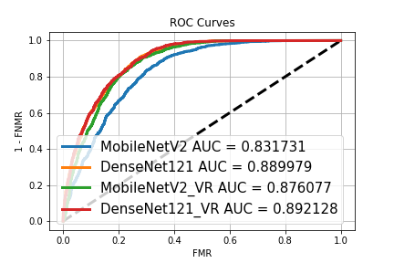
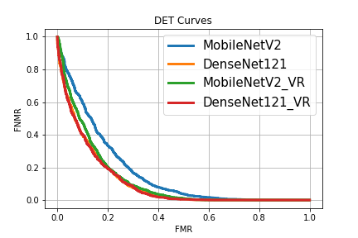
Model Performance

Slide 24
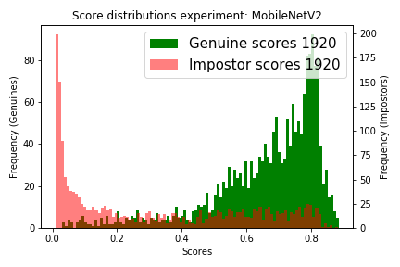
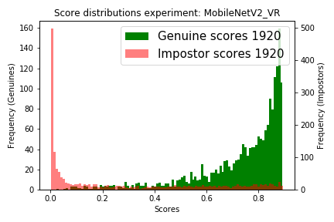
Model Performance
Scores Distribution [ P(y=1|x_ref, x_test) ]
MobileNetV2

Slide 25
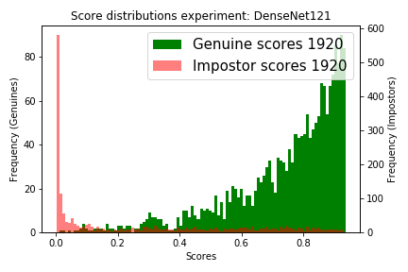
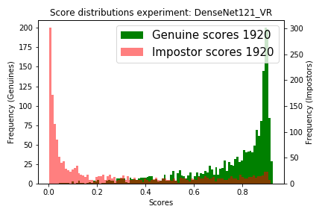
Model Performance
Scores Distribution [ P(y=1|x_ref, x_test) ]
DenseNet121

Slide 26
Model Performance
Model Equal Error Rate (EER)
Best model EER 19.74%
Not quite as good as in other works
Comparison
Le and Odobez (2018), Best model from scratch EER 10.31%
Jung, et. al. (2017), EER 7.61%

Slide 27
Mobile App Deployment

Slide 28
Mobile App Deployment
As part of a Master’s project, this voice authentication model was deployed onto an Android app
Voting scheme for authentication
To improve the performance of the authentication system, multiple votes from the authentication binary classifier network are considered in place of a single prediction
Votes per authentication request: 50
Voting threshold: 45 (90%) to be considered a genuine speaker
50 randomly generated pairs of spectrograms are generated from the pair of input utterance signals (7s per utterance)

Slide 29
Mobile App Deployment Overview
Mobile App / Client
Mobile app that provides an authentication service
Can be used for any application
Voice Authentication Server
Web server that provides voice-based authentication
Deep Learning (DL) model
Determine if two voice recordings are from the same person
Voice Authentication DL Model Training
DL model trained offline
DL model updated on to web server

Slide 30
Mobile App Deployment Overview
User Registration Overview
User profile registration (black)
User voice reference capture (red)
Save User Info
Firebase
Database
User Info
User
Mobile App/Device
Firebase
Storage
User Voice Sample
Save User Voice Sample

Slide 31
Mobile App Deployment Overview
User Authentication Overview
User profile and voice reference retrieval (black)
User live voice capture and authentication (red)
Firebase
Database
Check for user profile
Login
Retrieve User Info and Voice Reference
User
Firebase
Storage
Mobile App/Device
User Live Voice Sample
Authentication
Result
Voice Authentication Server (DL Model)
Live and Reference Voice Samples
Notes:
animations

Slide 32
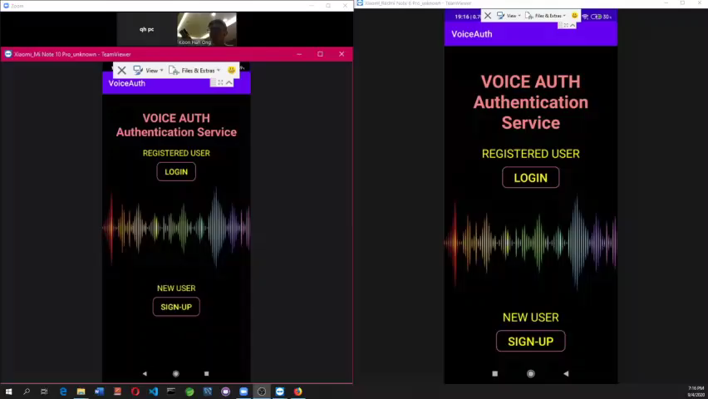
Demo Video

Slide 33
Thank you ☺

